Slide 1
Exercise 6 RENORMALIZATION GROUP
QUANTUM INFORMATION AND COMPUTING course 2021/2022
Alessandro marcomini (2024286)
Prof. Simone montangero

Slide 2

Exercise goals
Given the quantum Ising Hamiltonian in transverse field on a one-dimensional lattice with nearest neighbor interaction:
$H= λ\sum_{i}^{N}{σ_{z}^{i}}$ - $\sum_{i}^{N−1}{σ_{X}^{i}}$ $σ_{X}^{i+1}$
Compute the ground state energy as a function of the transverse field λ by means of the real-space RG algorithm.
RG IDEA
Consider a N-size one-dim system described by a given Hamiltonian (TFI)
Consider the 2N-size system described by the concatenation of the previous ones
Diagonalize such Hamiltonian and approximate it as the projection onto the N-size subspace of minimal energies, then iterate (cheap simulation of larger systems)

Slide 3

IN THEORY…
For spin 1/2 particles in the chain, the TFI Hamiltonian scales as ${n=2}^{N}$ (exact diagonalization of 10+ particles system is already computational demanding…)
Real-field RG allows to simulate chains of millions of particles by keeping only the most relevant information of the Hamiltonian low-energy states. In practice, the simulation size N is defined and kept constant while at each iteration the ful-system diagonal Hamiltonian is approximated by the projection onto the N-dimensional subspace of lower energy. This procedure allows to double the size of the simulated chain at each iteration.
Theoretically speaking, we encounter the thermodynamical limit for $N→∞$. In this scenario the energy per spin is constant. We see that RG allows to display this behaviour.

Slide 4
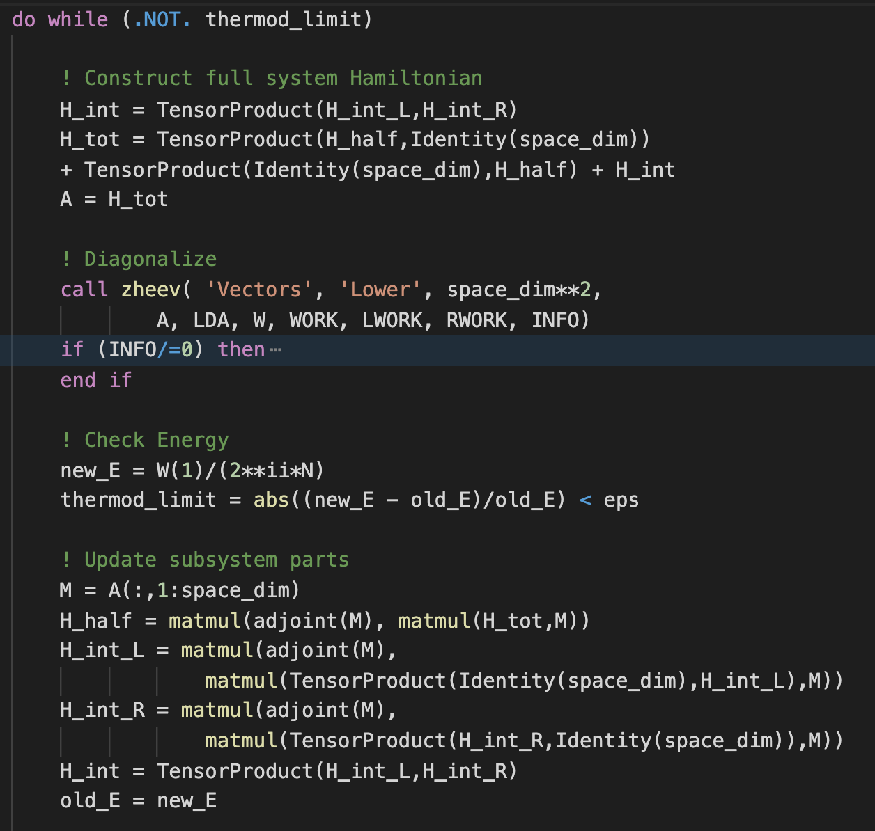

CODE DEVELOPEMENT
Create first four components:
$H_{TFI}^{L}=H_{half}⊗1_{n} , H_{INT}^{L}=1_{n−1}⊗σ^{X}$ and same for R
Compose them to create 2N-system Hamiltonian
Diagonalize it, store first $n$ eigenvectors in M matrix
Perform matrix-matrix multiplication to project into low-energy eigenspace

Slide 5

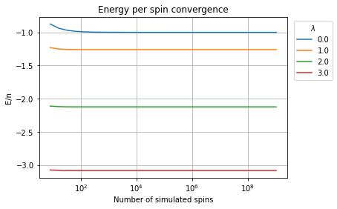
Trend of energy per spin enlarging the system
*initial N=4

Slide 6

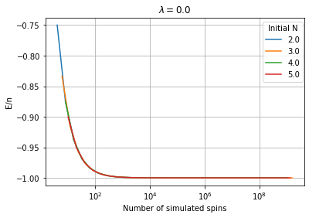
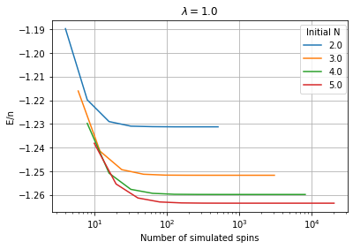
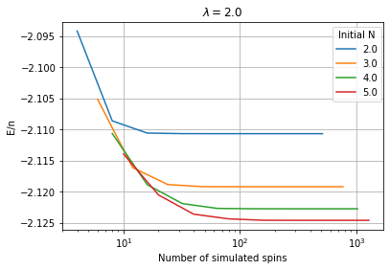
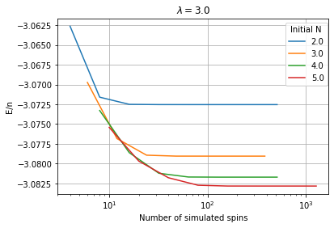

Dependency oN initial subsystems sizes (n)
Perfect alignment for $λ=0$ (as expected: hamiltonian composed of single-particle operators)
Different values of convergence by changing N for larger $λ$ ( variations of $O(0.1\%)$ )
Number of iterations required before convergence* is independent on N
*Convergence: relative change in energy per spin $< {10}^{−9}$

